Slide 1
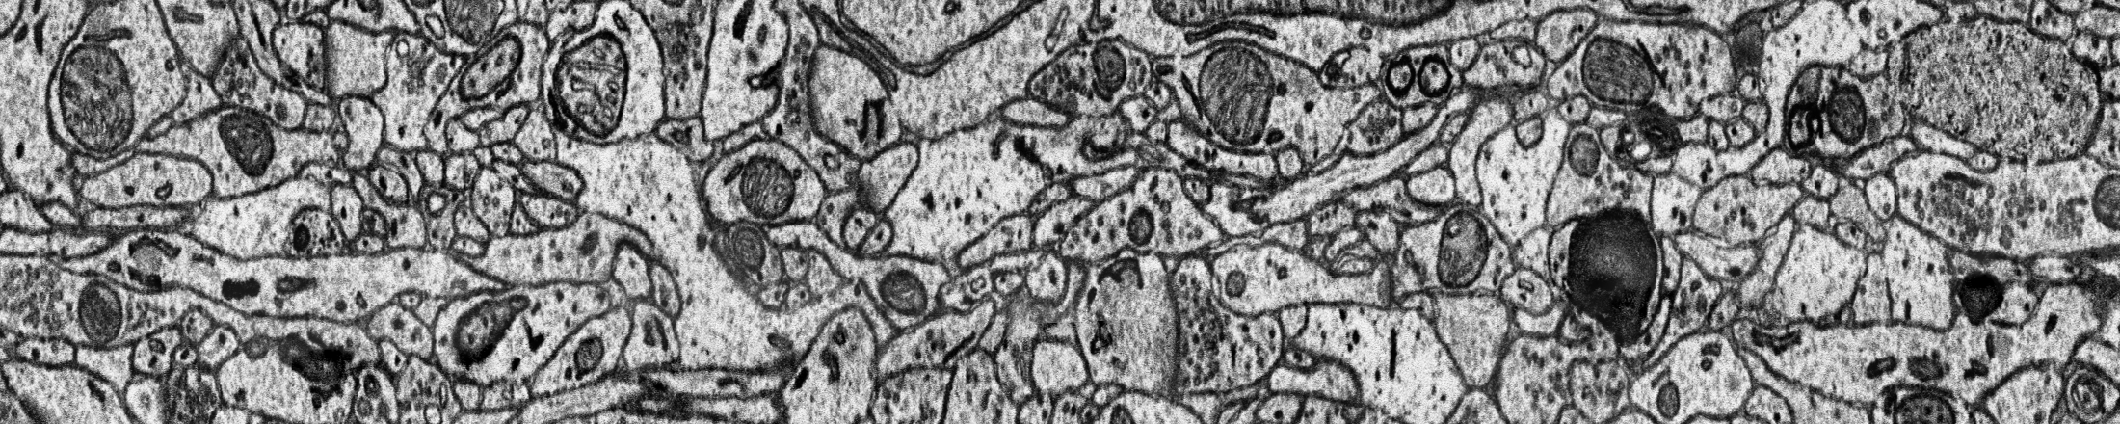





Advanced Deep Networks for 3D Mitochondria Instance Segmentation
Mingxing Li, Chang Chen, Xiaoyu Liu, Wei Huang, Yueyi Zhang, Zhiwei Xiong
University of Science and Technology of China

Slide 2

Outline
Dataset
Challenge
Method
Experiment

Slide 3
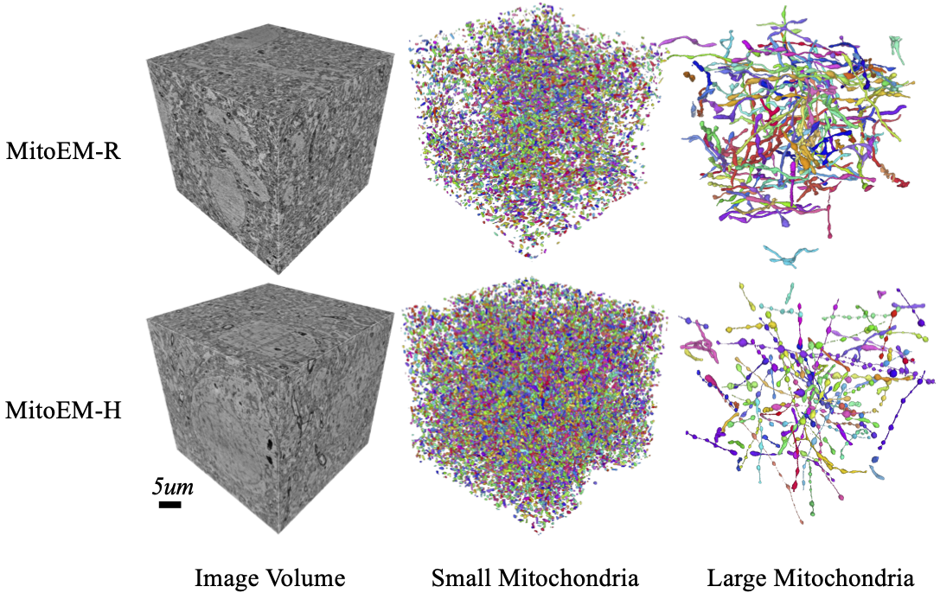
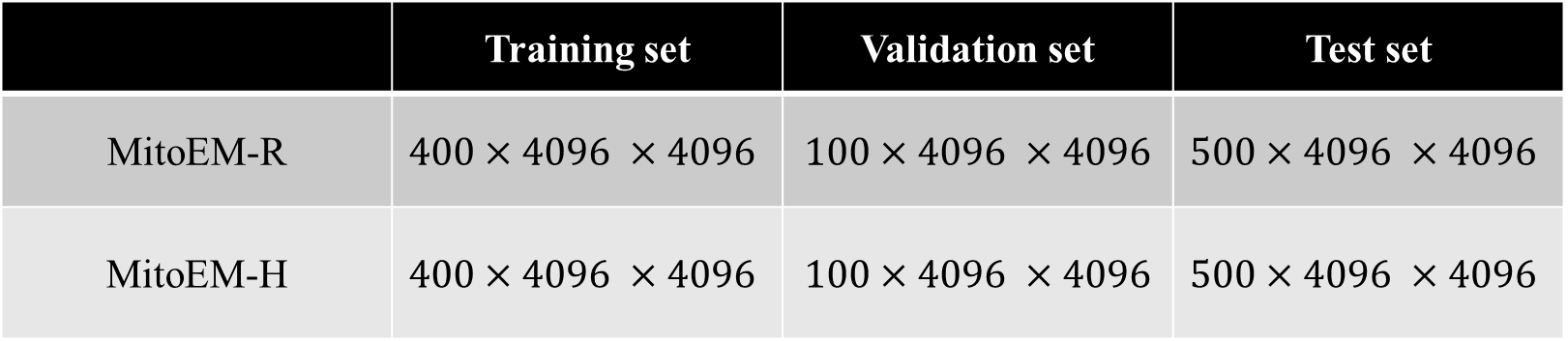
Dataset
 | Training set | Validation set | Test set
MitoEM-R | $$400×4096 ×4096$$ | $$100×4096 ×4096$$ | $$500×4096 ×4096$$
MitoEM-H | $$400×4096 ×4096$$ | $$100×4096 ×4096$$ | $$500×4096 ×4096$$

Slide 4
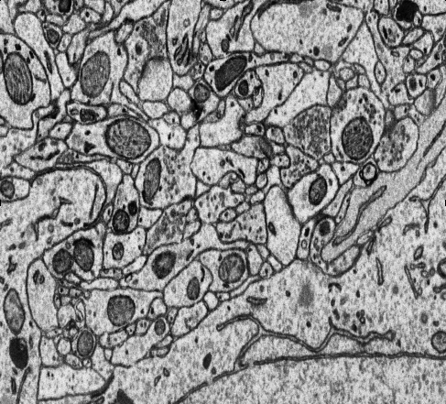
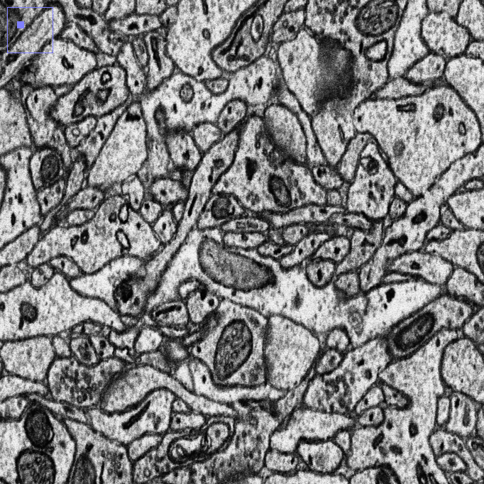
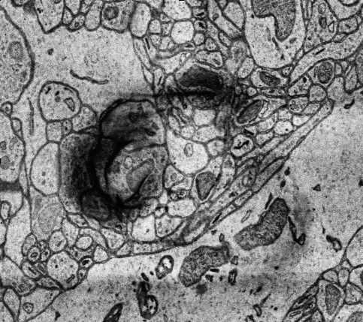
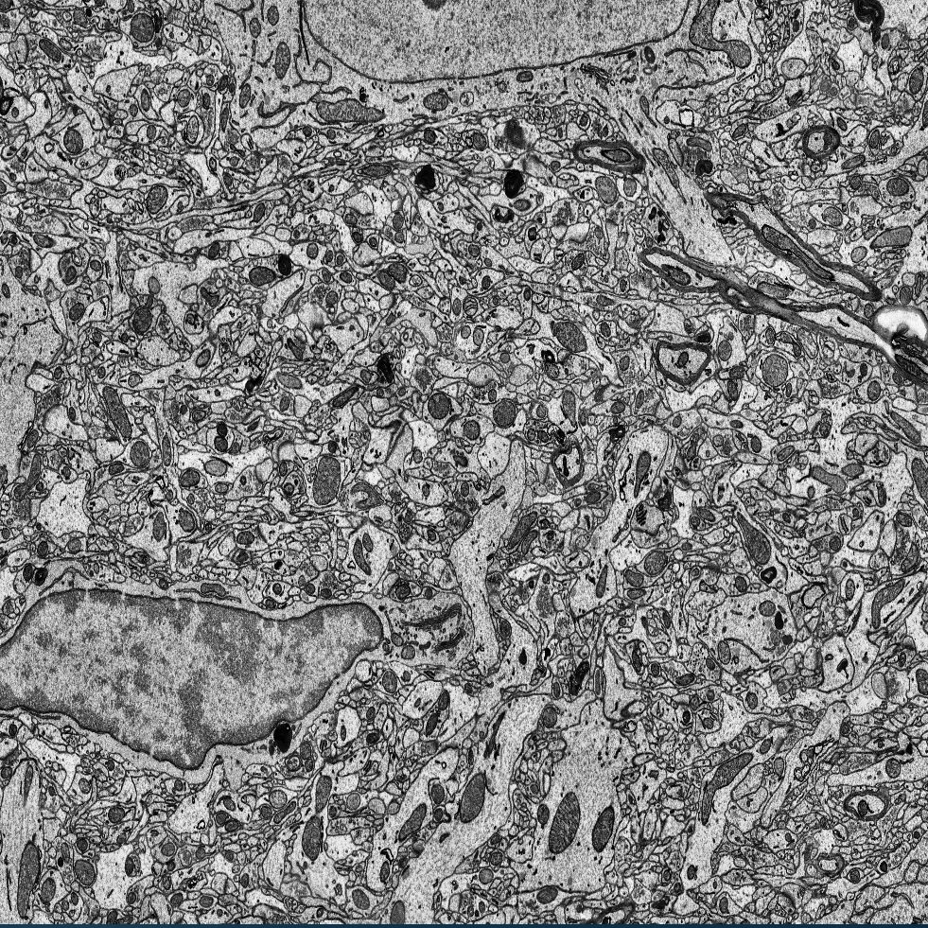
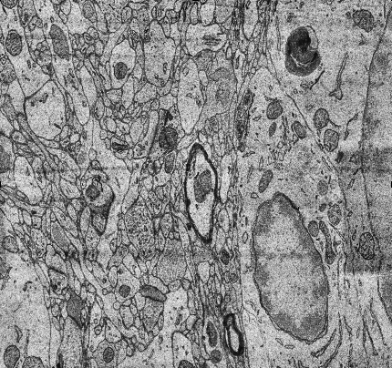
Challenge
Two modalities
Dense instances
Noise
High resolution
4096
4096

Slide 5
Challenge
Two modalities
Dense instances
Noise
High resolution
4096
4096
For different modalities, we propose two advanced deep residual networks, named Res-UNet-H for the human sample and Res-UNet-R for the rat sample in the MitoEM dataset.

Slide 6
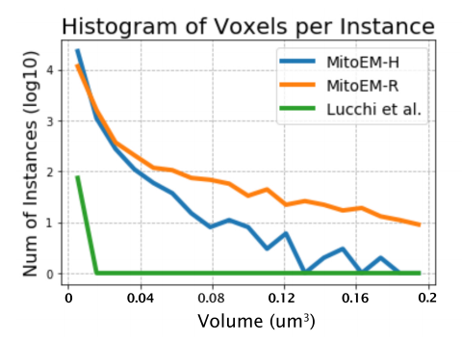
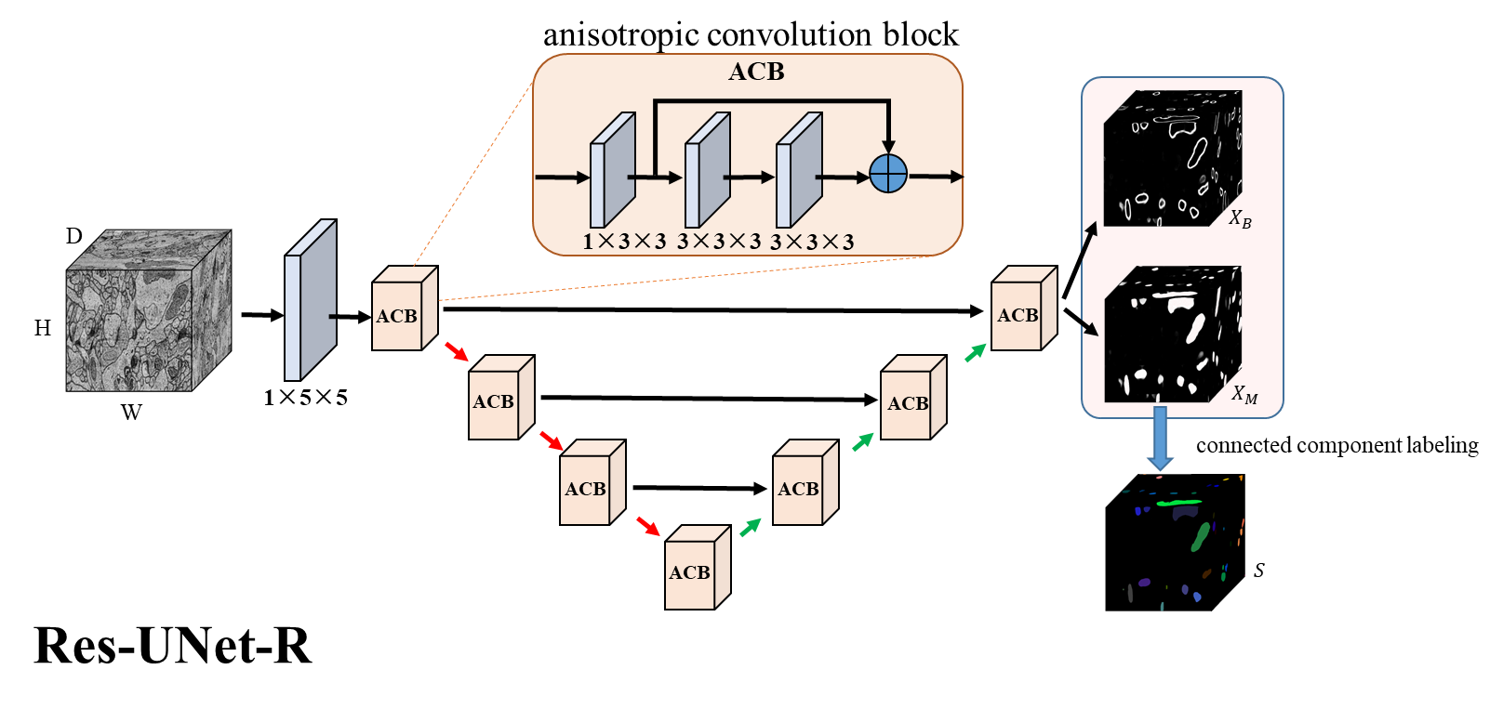
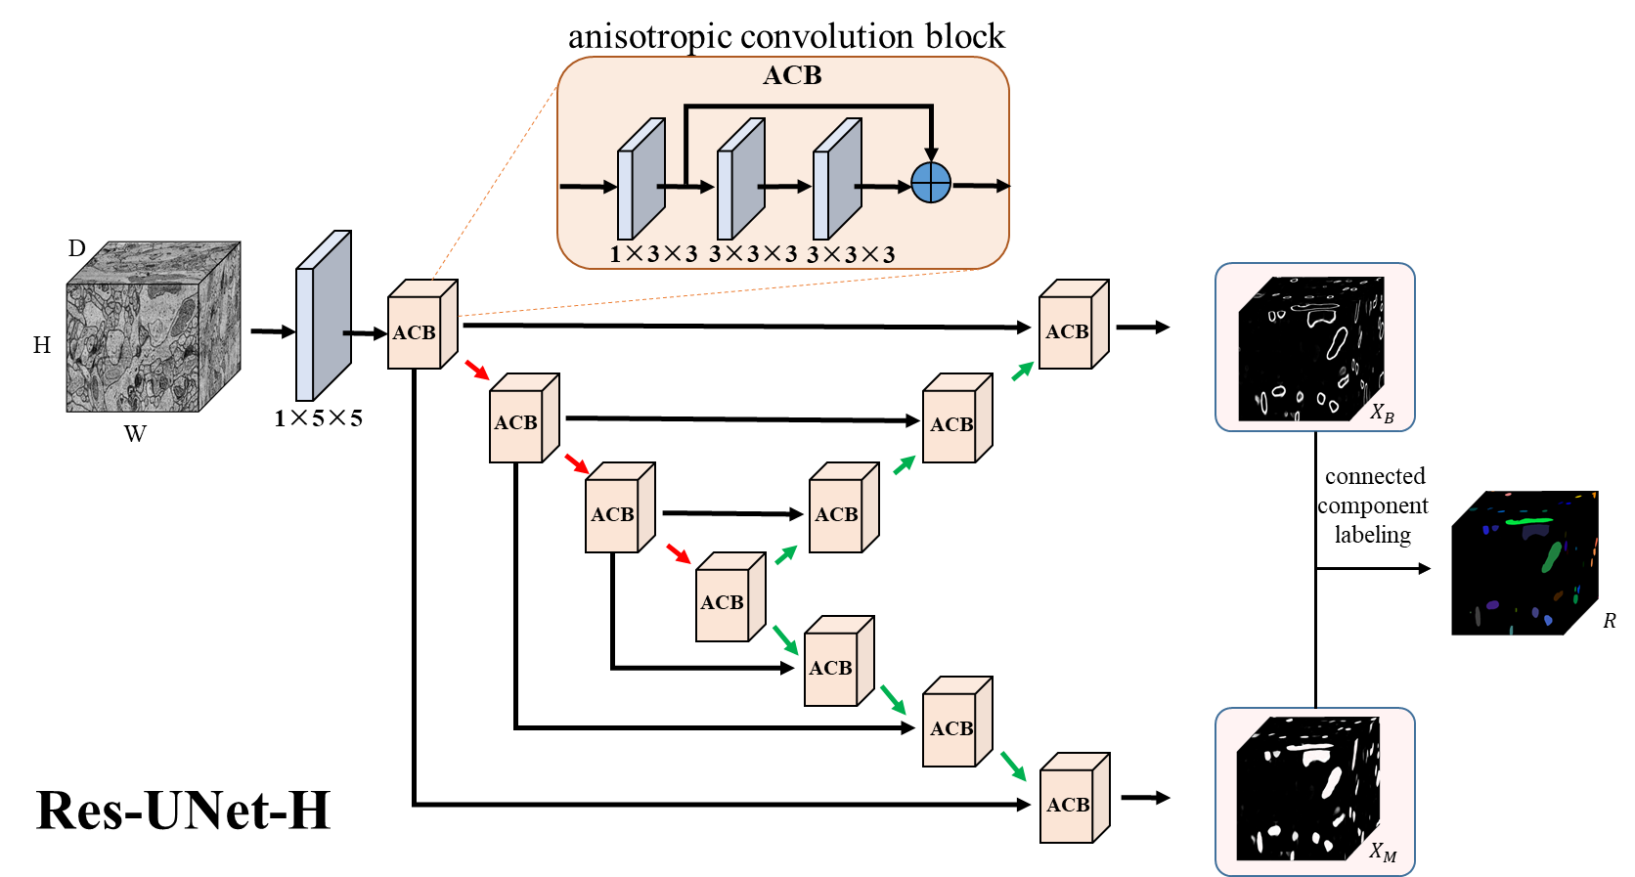
Method
Overall framework
From [1]
[1] Wei, Donglai, et al. "MitoEM Dataset: Large-Scale 3D Mitochondria Instance Segmentation from EM Images." In MICCAI, 2020.

Slide 7
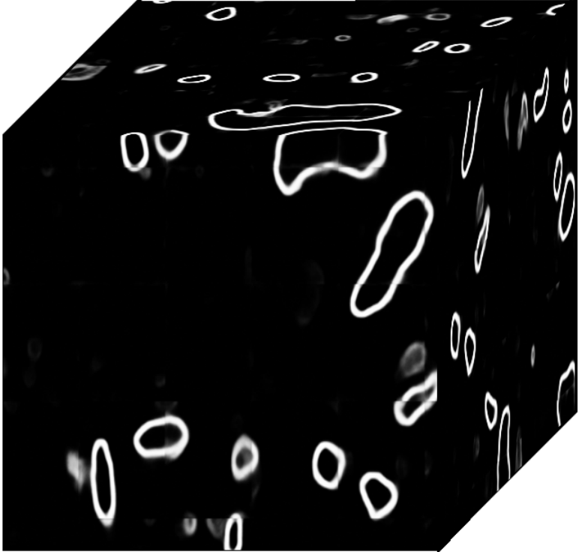
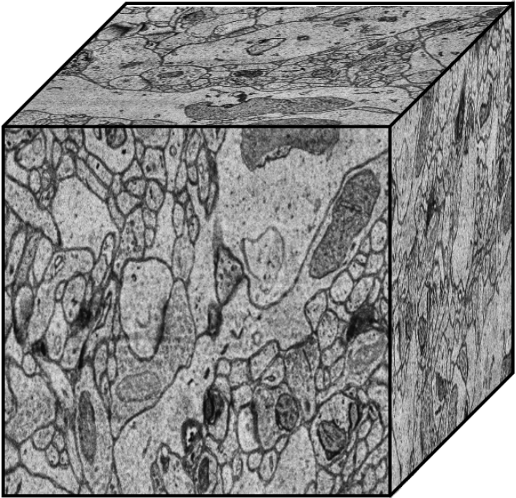
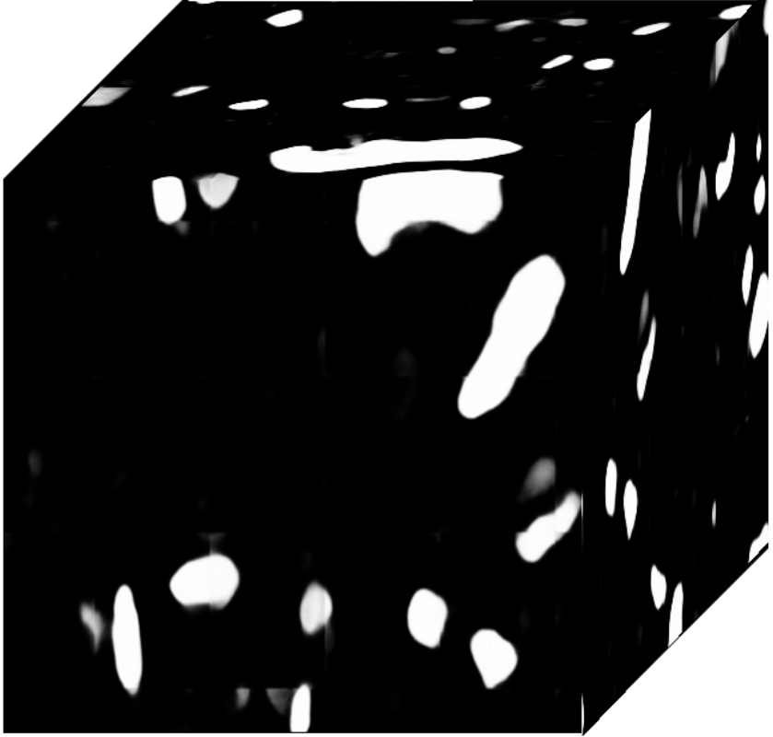
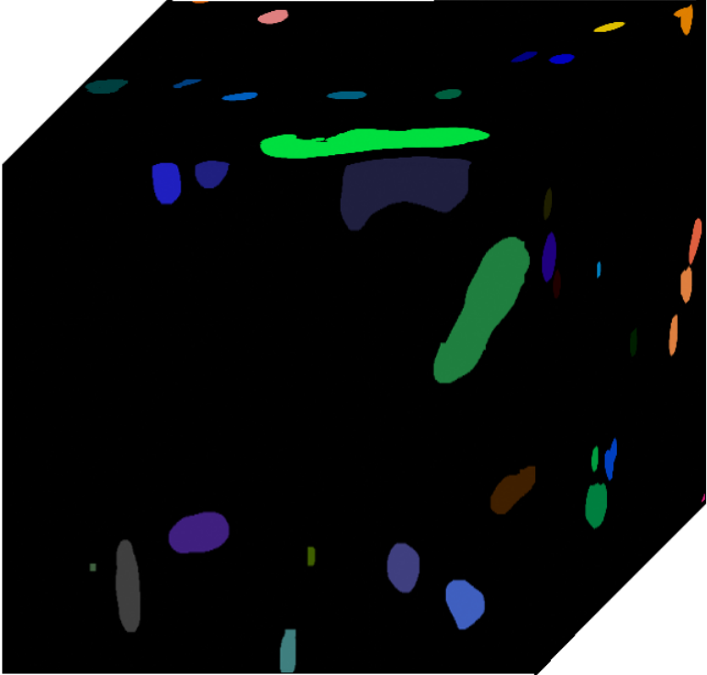
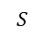
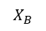
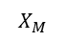
Method
anisotropic convolution block
Overall framework
ACB
D
$$X_{B}$$
1×3×3
3×3×3
3×3×3
H
ACB
ACB
W
1×5×5
ACB
ACB
$$X_{M}$$
connected component labeling
ACB
ACB
ACB
$$S$$
Res-UNet-R
Conv layer + ELU
Element-wise
summation
1×3×3 Conv,
Stride = 1×2×2
Trilinear
Interpolation

Slide 8
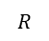
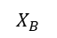
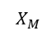
Method
anisotropic convolution block
Overall framework
ACB
D
1×3×3
3×3×3
3×3×3
H
ACB
ACB
W
1×5×5
ACB
ACB
$$X_{B}$$
connected component labeling
ACB
ACB
ACB
$$R$$
ACB
ACB
Res-UNet-H
ACB
$$X_{M}$$

Slide 9
Challenge
Two modalities
Dense instances
Noise
High resolution
4096
4096
To handle dense instances, both networks predict the semantic mask and instance boundary separately, which helps the network to better distinguish different instances.

Slide 10
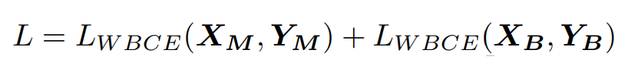
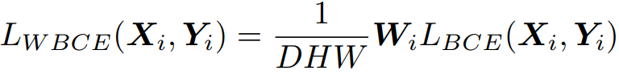
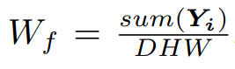
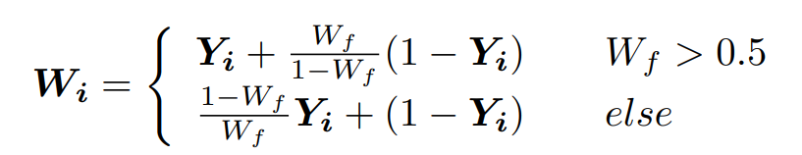
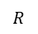
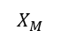
Method
For each prediction $X_{i}$ ($X_{M} or X_{B}$) , the corresponding Ground-truth is $Y_{i}$ ($Y_{M} or Y_{B}$) .
The overall loss:
$$X_{B}$$
Standard Weighted BCE loss:
$$X_{M}$$
connected
component
labeling
Foreground voxel ratio:
$$R$$
Weight:

Slide 11
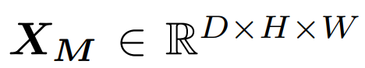
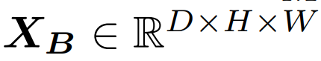
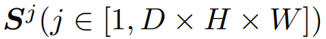
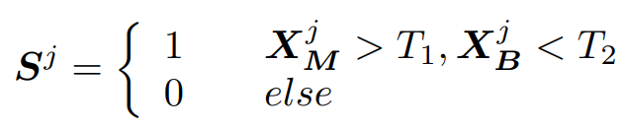
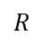
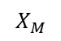
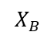
Method
$$X_{M}$$
Seed map
connected component labeling
$$R$$
$$X_{B}$$
Seed map

Slide 12
Challenge
Two modalities
Dense instances
Noise
High resolution
4096
4096
To alleviate the influence of noise to segmentation, we utilize an interpolation network to restore the noisy regions coarsely marked by labor.

Slide 13
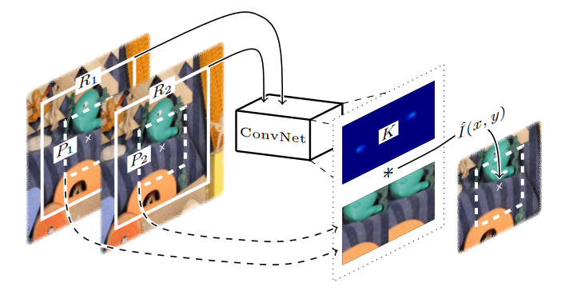
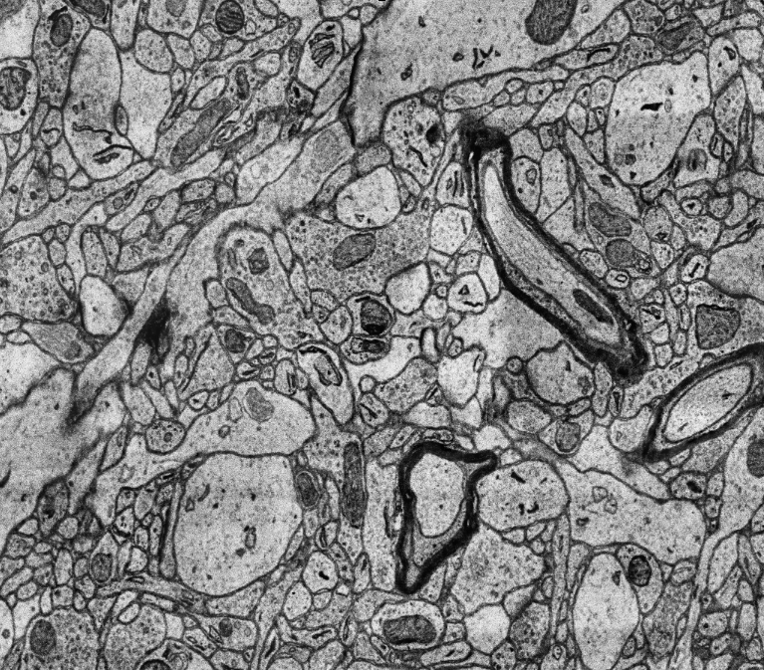
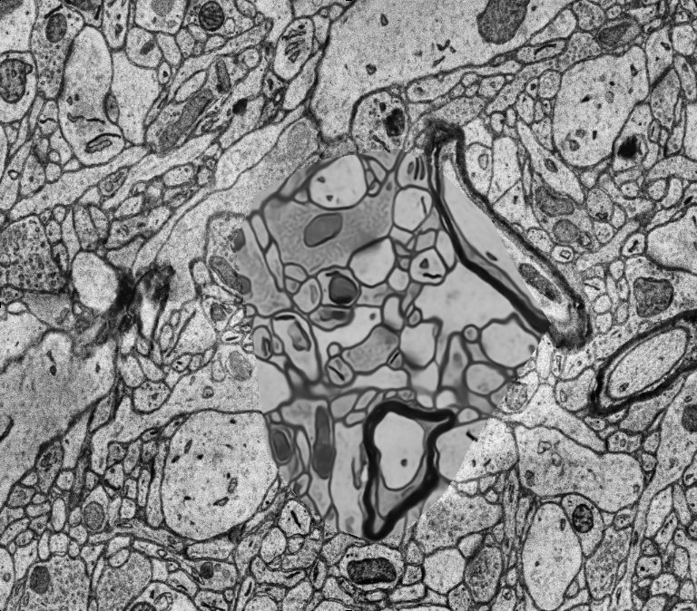
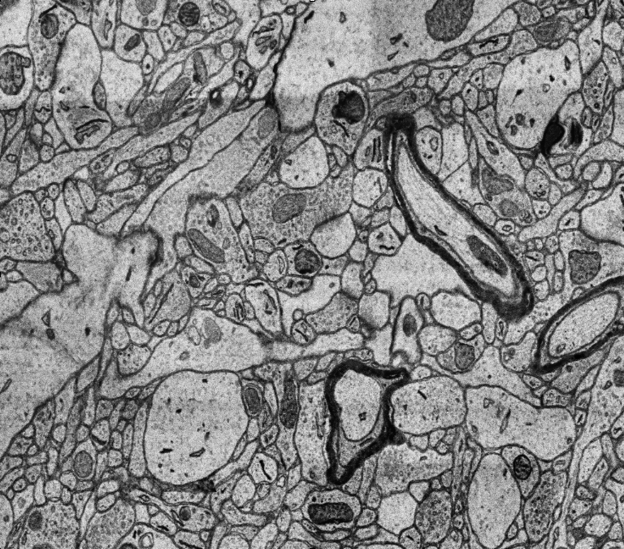
Method
Frame i-1
3×3
Kernel
Frame i
CNN
Frame i+1
Element-wise
summation
3×3
Video Frame Interpolation [2]
Interpolation network
[2] Simon Niklaus, et al. “Video Frame Interpolation via Adaptive Convolution”. In CVPR, 2017

Slide 14
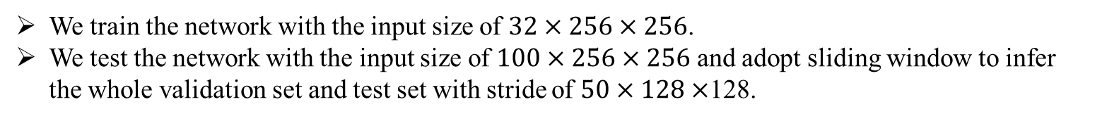
Challenge
Two modalities
Dense instances
Noise
High resolution
4096
4096
We train the network with the input size of $32×256×256$.
We test the network with the input size of $100×256×256$ and adopt sliding window to infer the whole validation set and test set with stride of $50×128×$128.

Slide 15
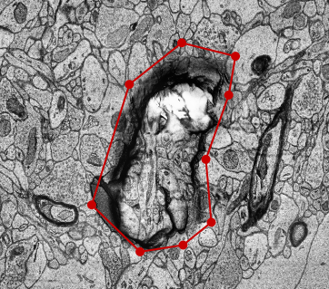
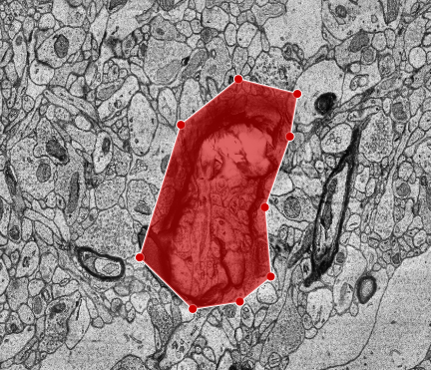
Experiment
Other implementation details
Pytorch 1.1 and two TITAN XP (12GB) GPUs for training and validation
Optimizer is Adam and the learning rate is 0.0001 and fixed in the training stage
Augmentation methods and metrics can refer to [3]
The validation stage needs almost 45 GB of memory
The test stage needs almost 215 GB of memory
Interpolation network
The test set is coarsely marked by labor.
[3] https://zudi-lin.github.io/pytorch_connectomics/build/html/tutorials/mito.html#instance-segmentation

Slide 16
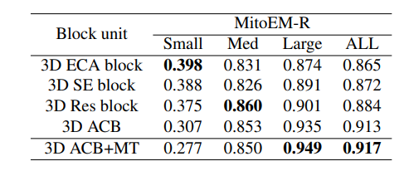
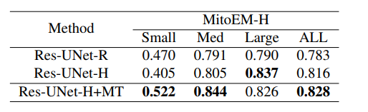
Experiment
Segmentation results on MitoEM-R validation set.
Segmentation results on MitoEM-H validation set
“+MT”: We train the network in the two stages. First, we train the network in 20K iterations with the input size of 32 × 256 × 256 to select the best model. Then we change the input size to 36 × 320 × 320 and fine-tune the network in 10K iterations. We call the two stage training as multi-scale training (MT).

Slide 17
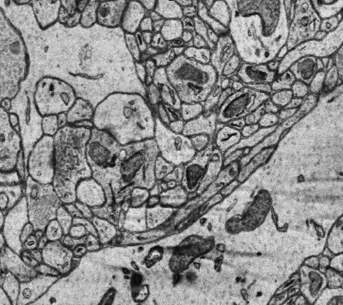
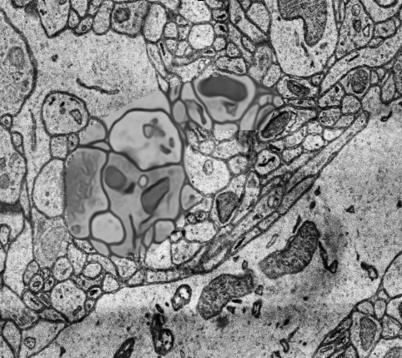
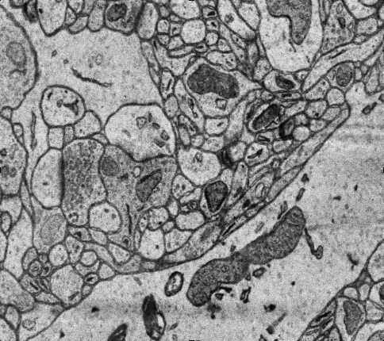
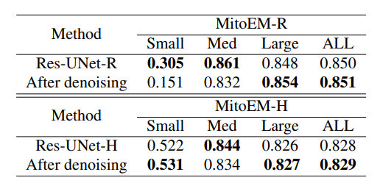
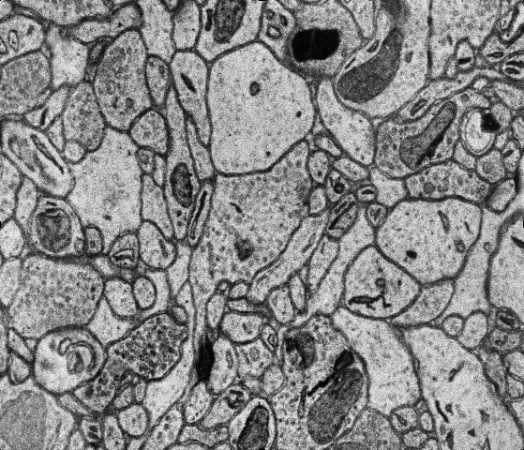
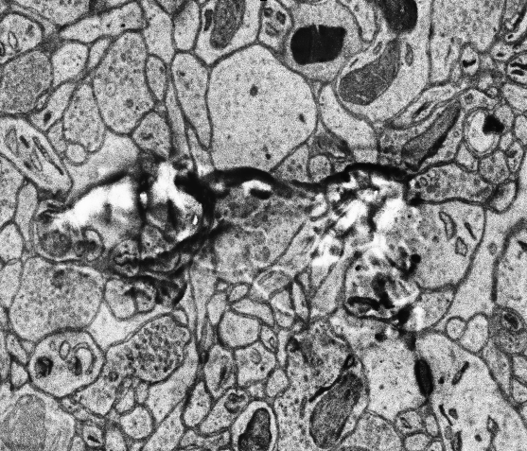
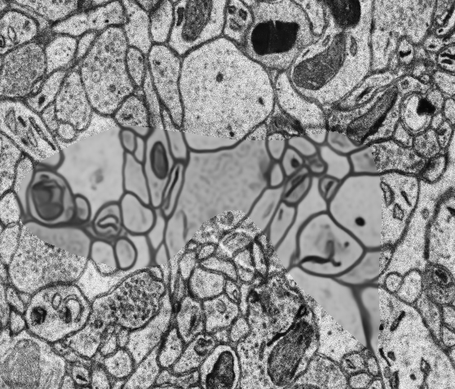

Experiment
Original
After denoising
Segmentation results on test sets of MitoEM-R and
MitoEM-H .
Frame i-1
Frame i
Frame i+1

Slide 18










Experiment
Image
Prediction
Ground-truth
Image
Prediction
Ground-truth
MitoEM-R
MitoEM-H

Slide 19



Experiment
Prediction 3D-viewer

Slide 20

Experiment
MitoEM Challenge leaderboard at the end of the testing phase.

Slide 21
Thank you!
If you have any question, please contact me:
mxli@mail.ustc.edu.cn

